Slide 1

Code Refactoring and Bug Fixing

Slide 2
Scenario:
A team of enthusiastic data scientists embarked on a mission to develop a Note Taking Application using Python,
Flask, and HTML. However, their lack of experience in backend development has led to challenges in making the
application fully functional. Recognizing your proficiency in backend development, you have been tasked with fixing
the broken code and ensuring the application works seamlessly.
Task:
Refactor the existing codebase and ensure the proper functioning of the Note Taking Application. Document all
identified bugs during the debugging process. Remember, the task is not about recreating the app from scratch.
Your goal is to fix the already existing codebase and make the application work as intended.

Slide 3
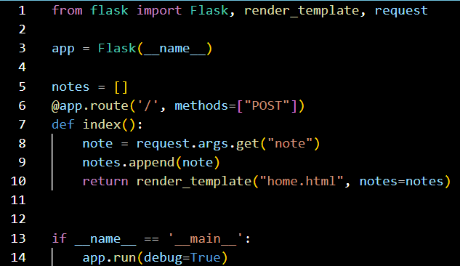
To do Task:
The application's home route contains a text field and a button. Users can add a note, and all the notes should be
displayed as an unordered list below the text field on the same page.
Given Code:

Slide 4
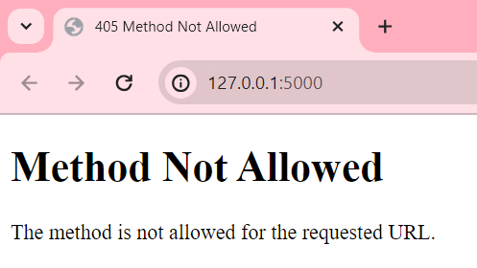
Output:
Since the given method is using “POST” in
app.py but in “home.html” it is using
“GET” method. So , we must add GET in
the router.
Bug 1:
I have added the required GET method in the app.py

Slide 5
Bug 2:
In the app.py file the base code contains “request.args.get(“note”) which only takes “POST”
requests but not the “GET” requests. I have updated the base code by changing it to
“request.form.get(“note”) as shown below.
This can handle both “GET” and “POST” requests.

Slide 6
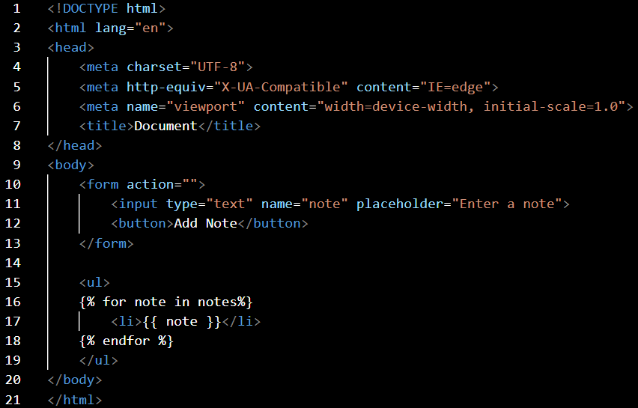
Given HTML base code:

Slide 7
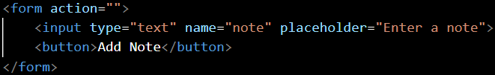
Bug 3:
From the above HTML code we can see that there is no type of the button to add note and action with method.
So, we must specify the action, method and button type to add a note as shown below.

Slide 8
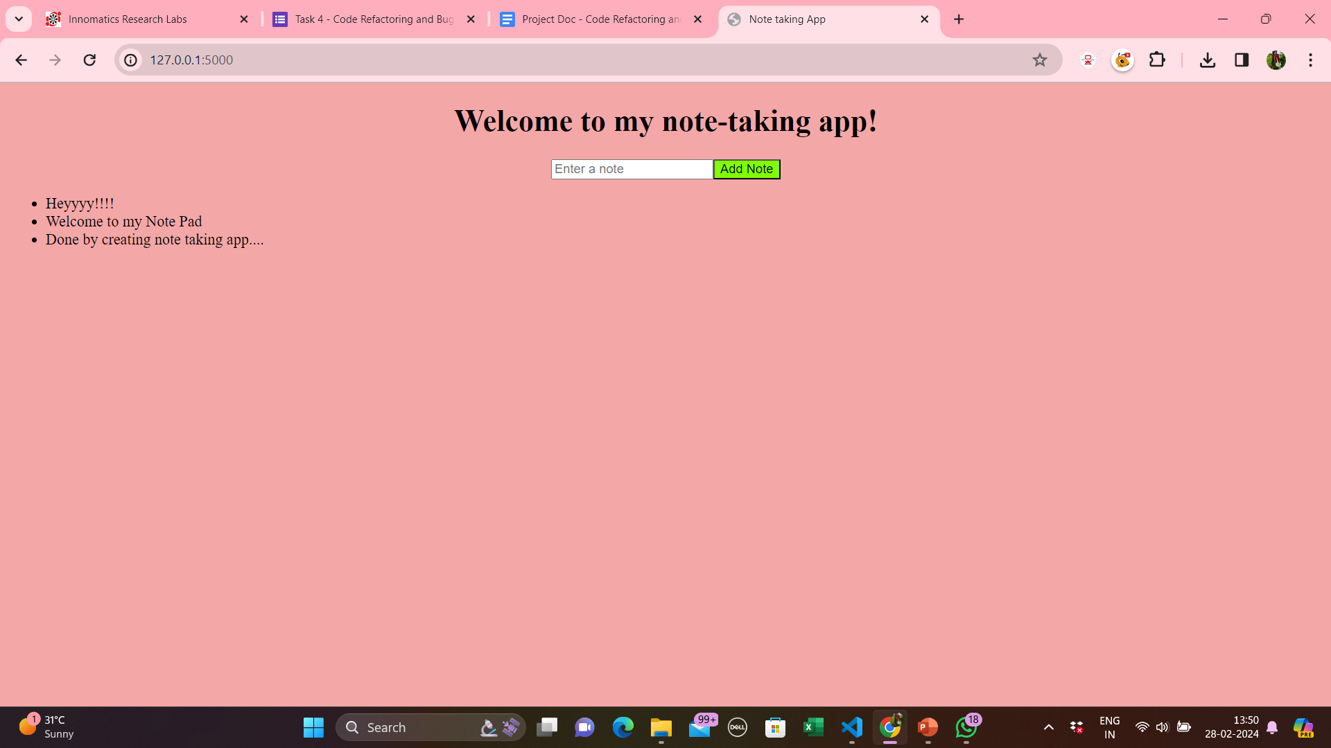

Slide 9

THANK YOU

